Slide 1
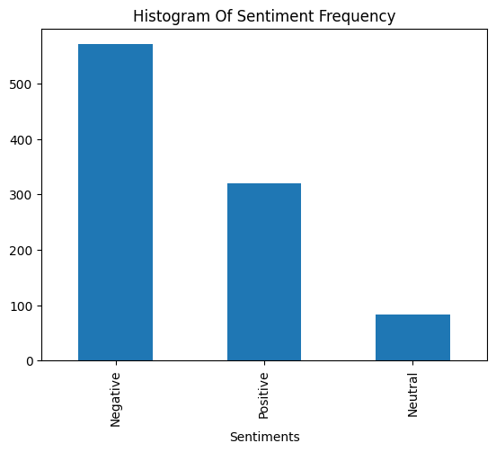
Roberta Sentimental Analysis
From the 1000 data points scrapped from the web, the following information was obtained:
58.62% of the reviews were negative.
32.85% of them were positive.
While 8.52% were neutral.

Slide 2
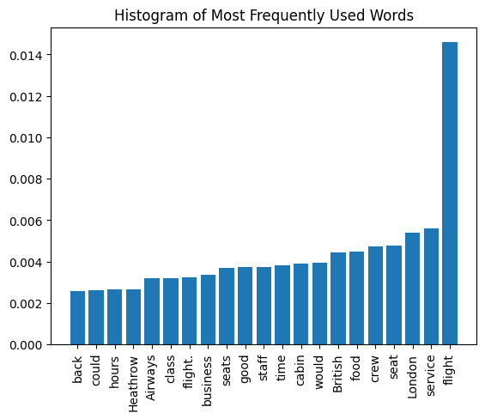
Words Frequency
The Bag of Words approach was used to determine the most frequent words used. Here, we observe that the top most frequently used words are flight, service, london, seat and crew

Slide 3
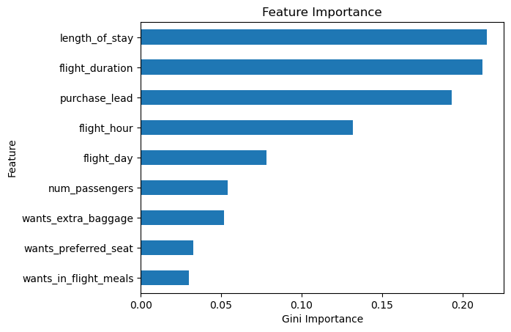
Presentation of Analysis
According to the model, it can been seen that length of stay helped the most in determining the likelihood of a customer booking for holiday.

Slide 4
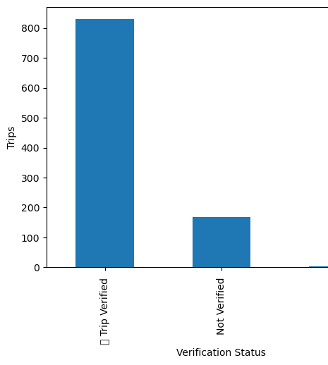
Number of customers whose trips have been verified

